Slide 1
Professional Issues in IT Ethical Theories
Dr. Aftab Maroof
NUCES, Islamabad Campus
(Lecture Slides Week # 3)

Slide 2
Ethical Theories
For centuries in different societies, human actions have been judged good or bad, right or wrong, based on theories or systems of justice developed, tested, revised, and debated by philosophers and/or elders in that society
Such theories are commonly known as Ethical Theories
Codes of ethics have then been drawn-up based on these ethical theories
The processes of reasoning, explanation, and justification used in ethics are based on these theories
Many ethical theories
Most widely discussed and used:
Consequentialism
Deontology
Human Nature
Relativism
Hedonism
Emotivism

Slide 3
Consequentialism Theory:
Human actions are judged good or bad, right or wrong, depending on the results, outcomes, ends, consequences of such actions
Harm minimization (actual or potential) is used as standard for deciding right vs. wrong. It leads to less unsatisfactory ethical decisions.
Greater good may also be considered; It leads to a more satisfactory decisions.
Three Types: Egoism, Utilitarianism, Altruism
Egoism:
Puts an individual’s interests and happiness above everything else
Any action is good as long as it maximizes an individual’s overall happiness
Good for me / Least harm to me
It is operating when you wish to maximize benefit to yourself, or minimize harm to yourself, with less consideration given to others

Slide 4
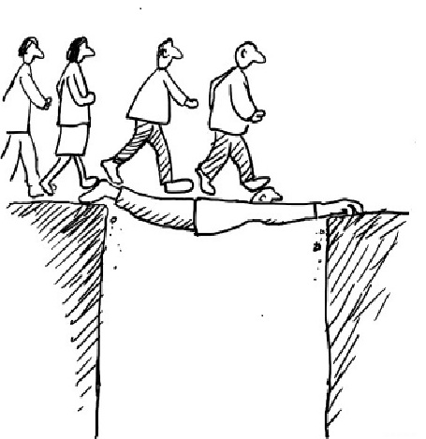

Slide 5
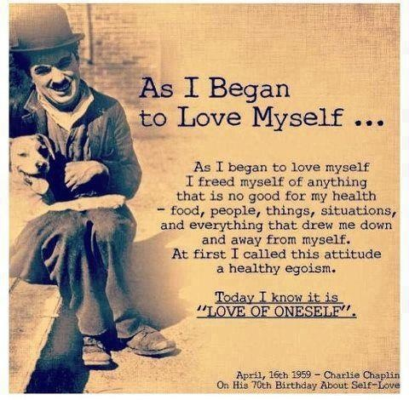

Slide 6
Consequentialism Theory
Utilitarianism:
Unlike egoism, this theory puts a group’s interest and happiness above those of an individual, for the good of many
Thus, an action is good if it benefits the maximum number of people
Good for the group, Least harm for the group
It allows you to consider primarily the good (or harm) to others affected by your decisions. Your reasoning is not self-centered but group centered, seeking the maximum good for the group. You are usually part of the group.

Slide 7


Slide 8
Consequentialism Theory
Altruism:
An action is right if the consequences of that action are favorable to all except the actor.
Good for all, Some harm to me
It is invoked when you sacrifice something for the benefit of others. You may suffer some harm, but the interests of others are advanced.
For example,
giving your lunch away is altruistic because it helps someone who is hungry, but at a cost of being hungry yourself.
Donating your money or time to a charity or to help someone, without trying to get recognition for it.
Notes:
Altruism can be distinguished from feelings of loyalty, in that whilst the latter is predicated upon social relationships, altruism does not consider relationships. Much debate exists as to whether "true" altruism is possible in human psychology. The theory of psychological egoism suggests that no act of sharing, helping or sacrificing can be described as truly altruistic, as the actor may receive an intrinsic reward in the form of personal gratification. The validity of this argument depends on whether intrinsic rewards qualify as "benefits."

Slide 9
Altruism vs. Compassion
Altruism and compassion are related concepts. Compassion is the ability to feel the pain and happiness of others, and truly to care about the well-being of others.
When we see someone devastated by loss or sadness, we feel some of that pain ourselves; and when that person gets help and starts to smile again, we have an urge to smile ourselves; that’s part of compassion—empathy—feeling other’s feelings.
But compassion also includes feeling motivated to help others, just because you want them to feel good. It’s one of the most basic concepts in every world religions and widely considered to be a key element in living a meaningful, fulfilling life.
Compassion is not the same as altruism
Compassion is the feeling that motivates altruism. With altruism, you act generously and helpfully to others without expecting any benefit for yourself. This may seem difficult if you don’t have great compassion; not difficult to help people, but difficult—some say impossible–not to want to get something for yourself.

Slide 10
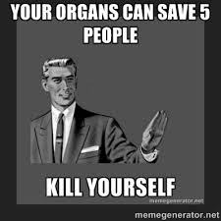

Slide 11
Ethical Decision Making
Deontological Theory:
Does not concern with the consequences of the action but rather with the will of the action
An action is good or bad depending on the will inherent in it
According to deontological theory, an act is considered good if the individual committing it had a good reason to do so
This theory has a duty attached to it
In fact, the word “deontology” comes from two Greek words, deon meaning duty, and logos meaning science
E.g. We know that killing is bad, but if an armed intruder enters your house and you kill him or her, your action is good, according to deontologists. You did it because you had a duty to protect your family and property.

Slide 12


Slide 13
Ethical Decision Making
Human Nature Theory:
Considers human beings as endowed with all faculties and capabilities to live in happiness.
We are supposed to discover and then develop those capabilities.
In turn, those capabilities become a benchmark for our actions, and our actions are then gauged and judged on how much they measure up to those capabilities.
According to the famous Greek philosopher Aristotle, an individual committing an evil action is lacking in some capabilities.

Slide 14
Relativism Theory:
Negatively formulated, denying the existence of universal moral norms.
It takes right and wrong to be relative to society, culture, or the individual.
Relativism also states that moral norms are not fixed in time.

Slide 15


Slide 16
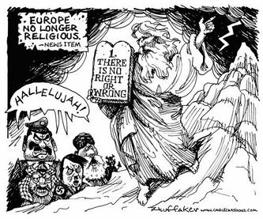

Slide 17
Ethical Decision Making
Hedonism Theory:
One of the oldest ethical theories.
It claims that pleasure / happiness is the only good thing in human life, the end of life as the highest good.
A hedonist acts only for maximum pleasure and whatever he or she does, it is done to maximize pleasure or minimize pain.

Slide 18
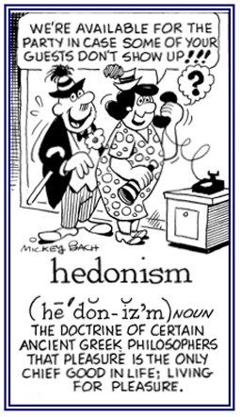

Slide 19
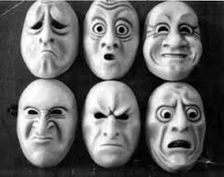
Emotivism Theory:
This theory maintains that ethical statements are neither true nor false and cannot be proven; they are really only statements about how someone understand / feel

